Slide 1

ANGULAR 2

Slide 2
From Intro to Setup
Why Angular 2
What Can We Build?
Language Choices
Typescript (Intro)
Setup
Angular CLI

Slide 3
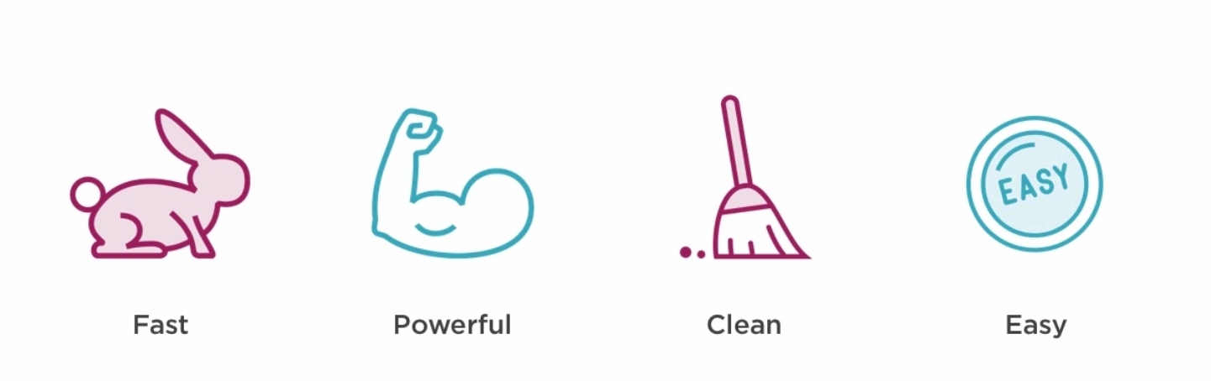
WHY ANGULAR 2

Slide 4
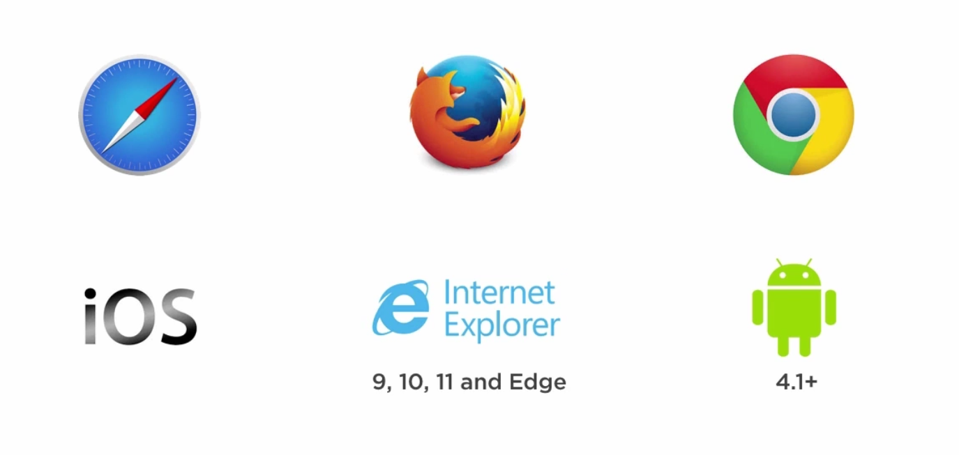

WHAT CAN WE BUILD?
Web & Mobile
Desktop
http://electron.atom.io/

Slide 5



LANGUAGE CHOICES

Slide 6
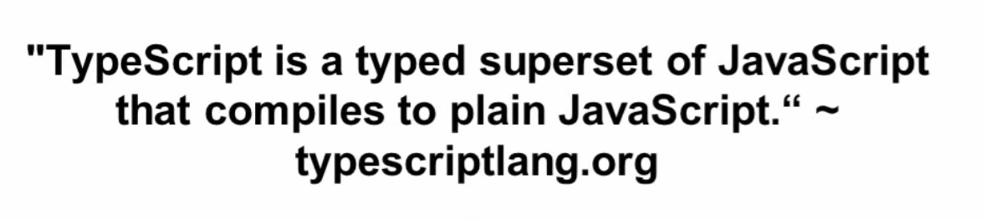
TYPESCRIPT
What is?

Slide 7
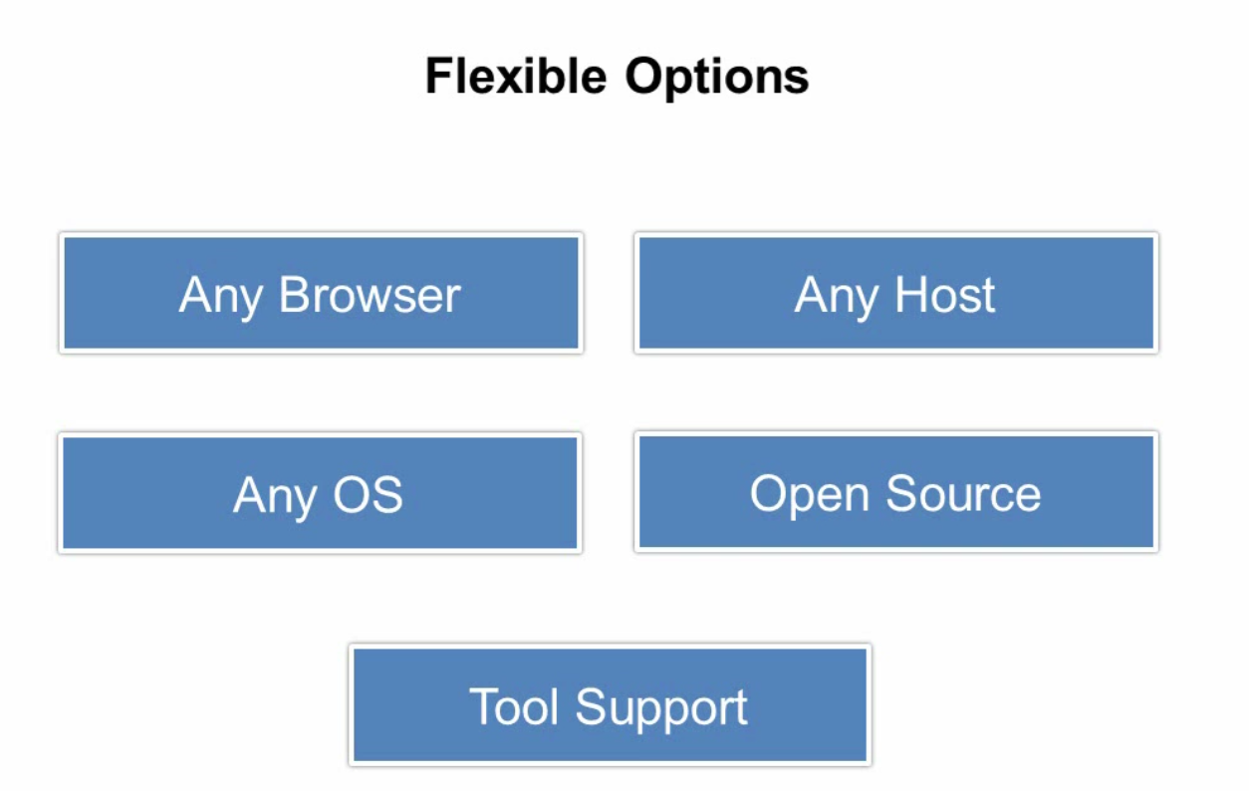
TYPESCRIPT

Slide 8
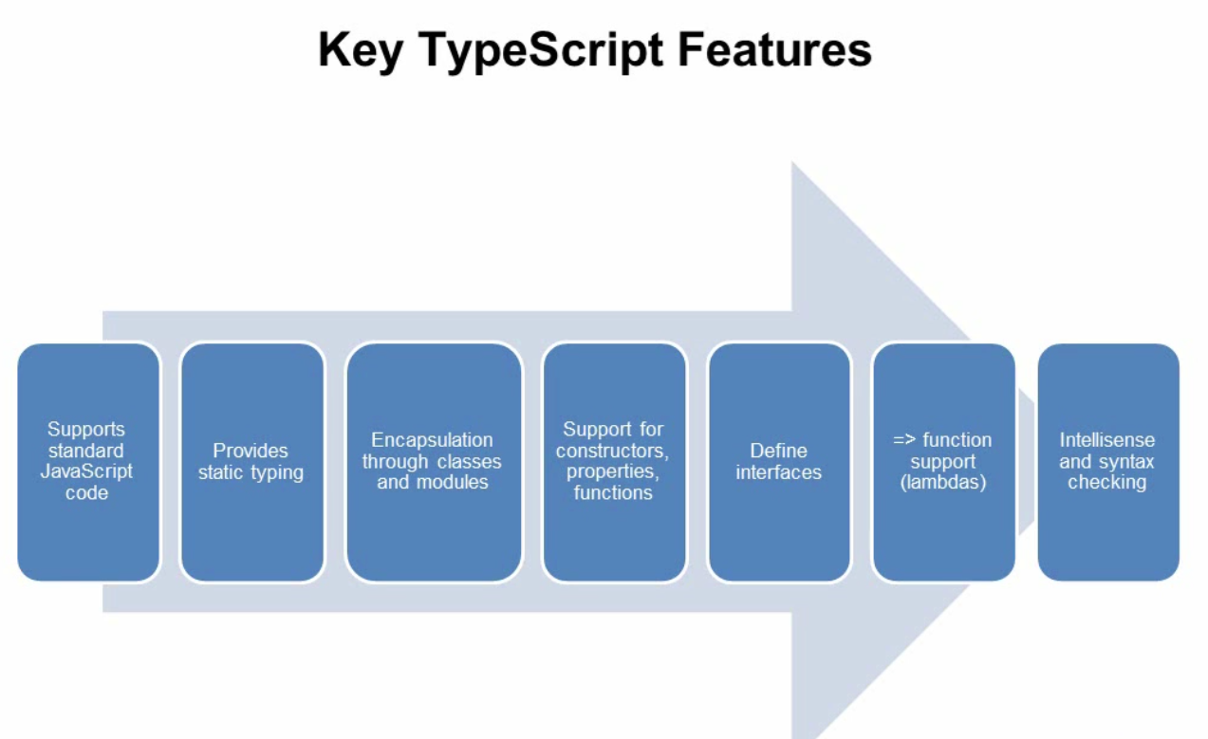
TYPESCRIPT

Slide 9
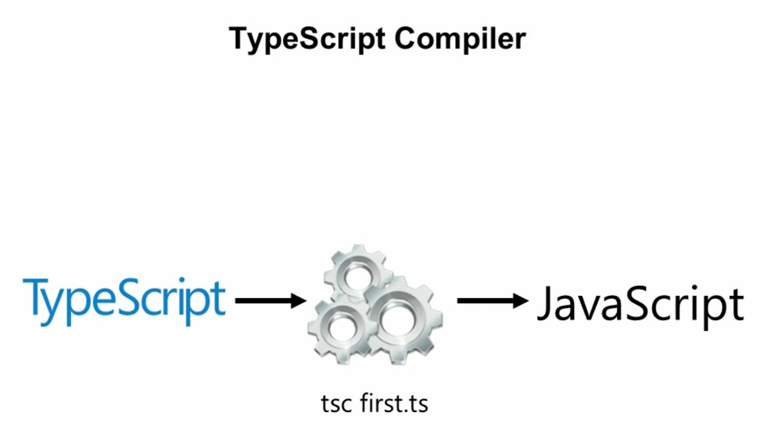
TYPESCRIPT

Slide 10
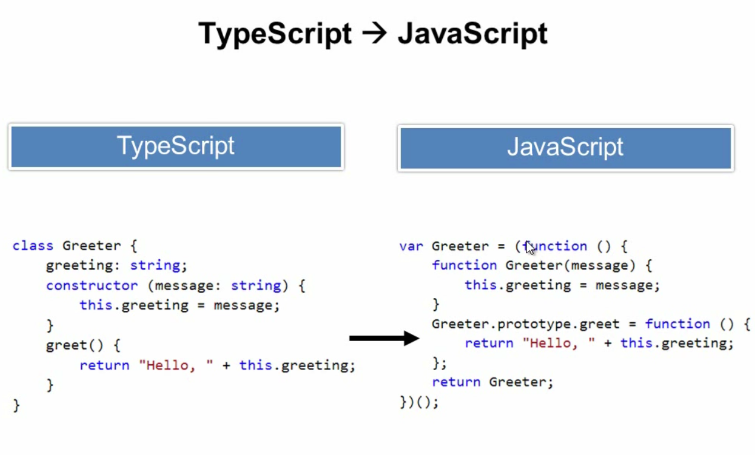
TYPESCRIPT

Slide 11
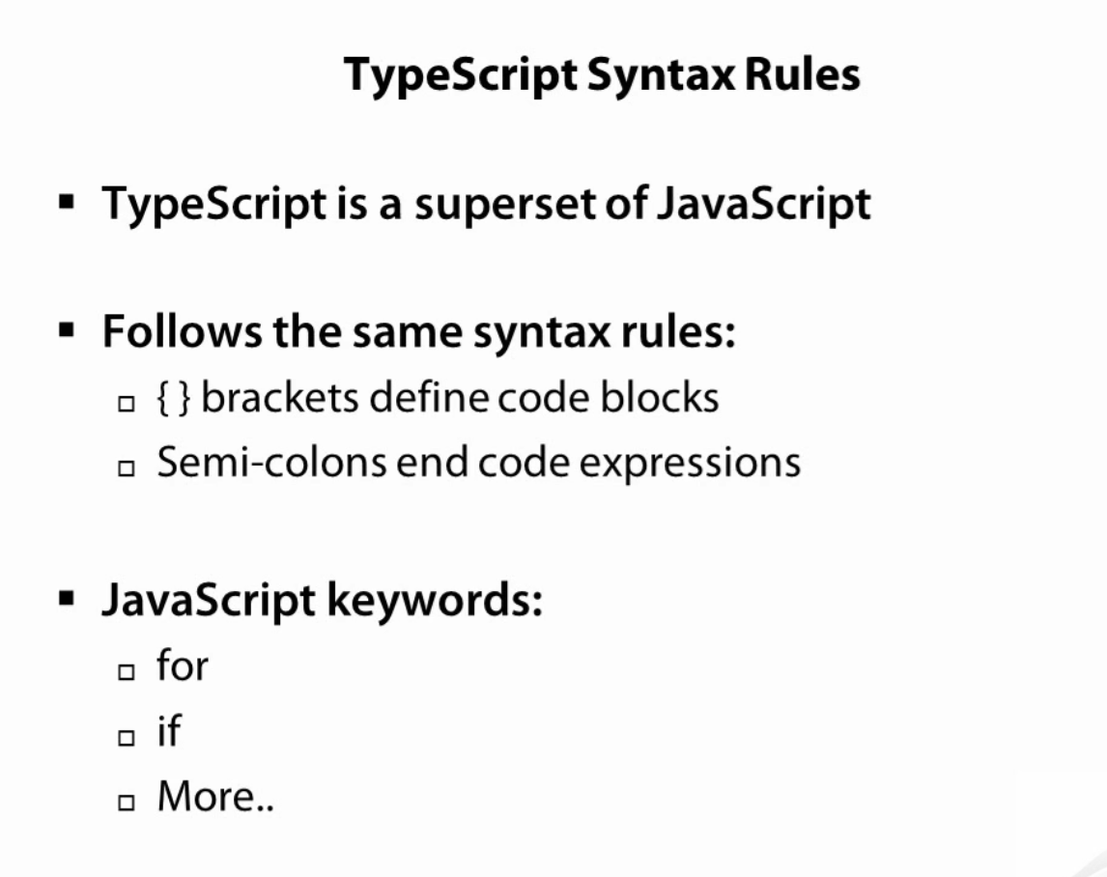
TYPESCRIPT

Slide 12
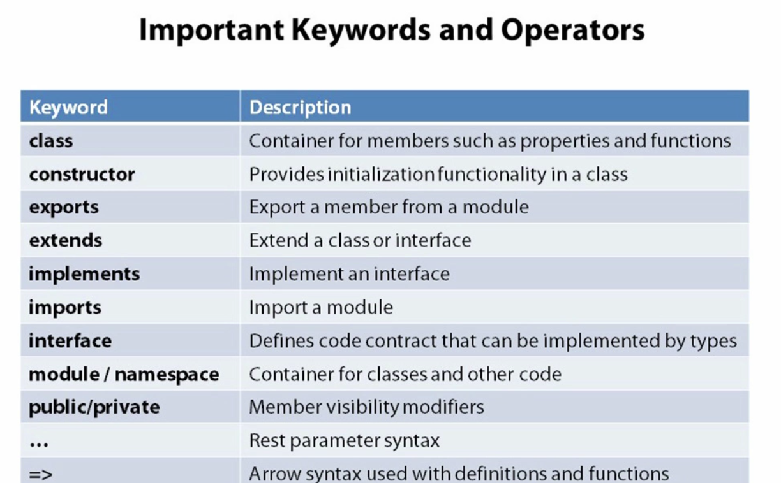
TYPESCRIPT

Slide 13
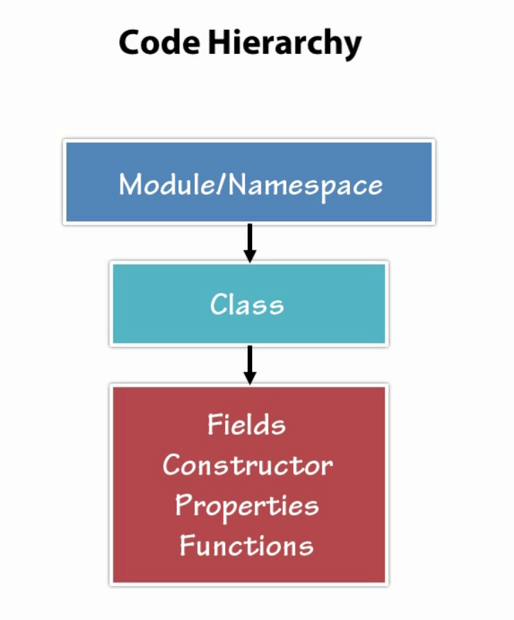
TYPESCRIPT

Slide 14
NODE.JS
Download from https://nodejs.org/en/
Install Setup exe
Open CMD
Type
node --version
npm --version
SETUP
Node.js & NPM
typescript
Angular CLI
Visual Studio Code
TYPESCRIPT
npm install -g typescript
Type: tsc --version
ANGULAR CLI
npm install –g angular-cli
Type: ng --version
Visual Studio Code
Download from https://code.visualstudio.com/
Install Setup exe
Open CMD
Type
Code .

Slide 15
ANGULAR CLI
A command line interface for Angular

Slide 16
Starwars tracker App
ng new starwars-tracker
cd starwars-tracker
code .
ng serve

